Slide 1
RHS Sixth Form Induction Day
Student Leadership, Guest Speaker Programme and Success in the Sixth Form
Miss Kingscott
Assistant Head of Year 13
Teacher of Sociology, Psychology and Health and Social Care
Tutor of C63
Notes:
My topics: Enrichment, speaker programme and what makes a successful Sixth Form student

Slide 2
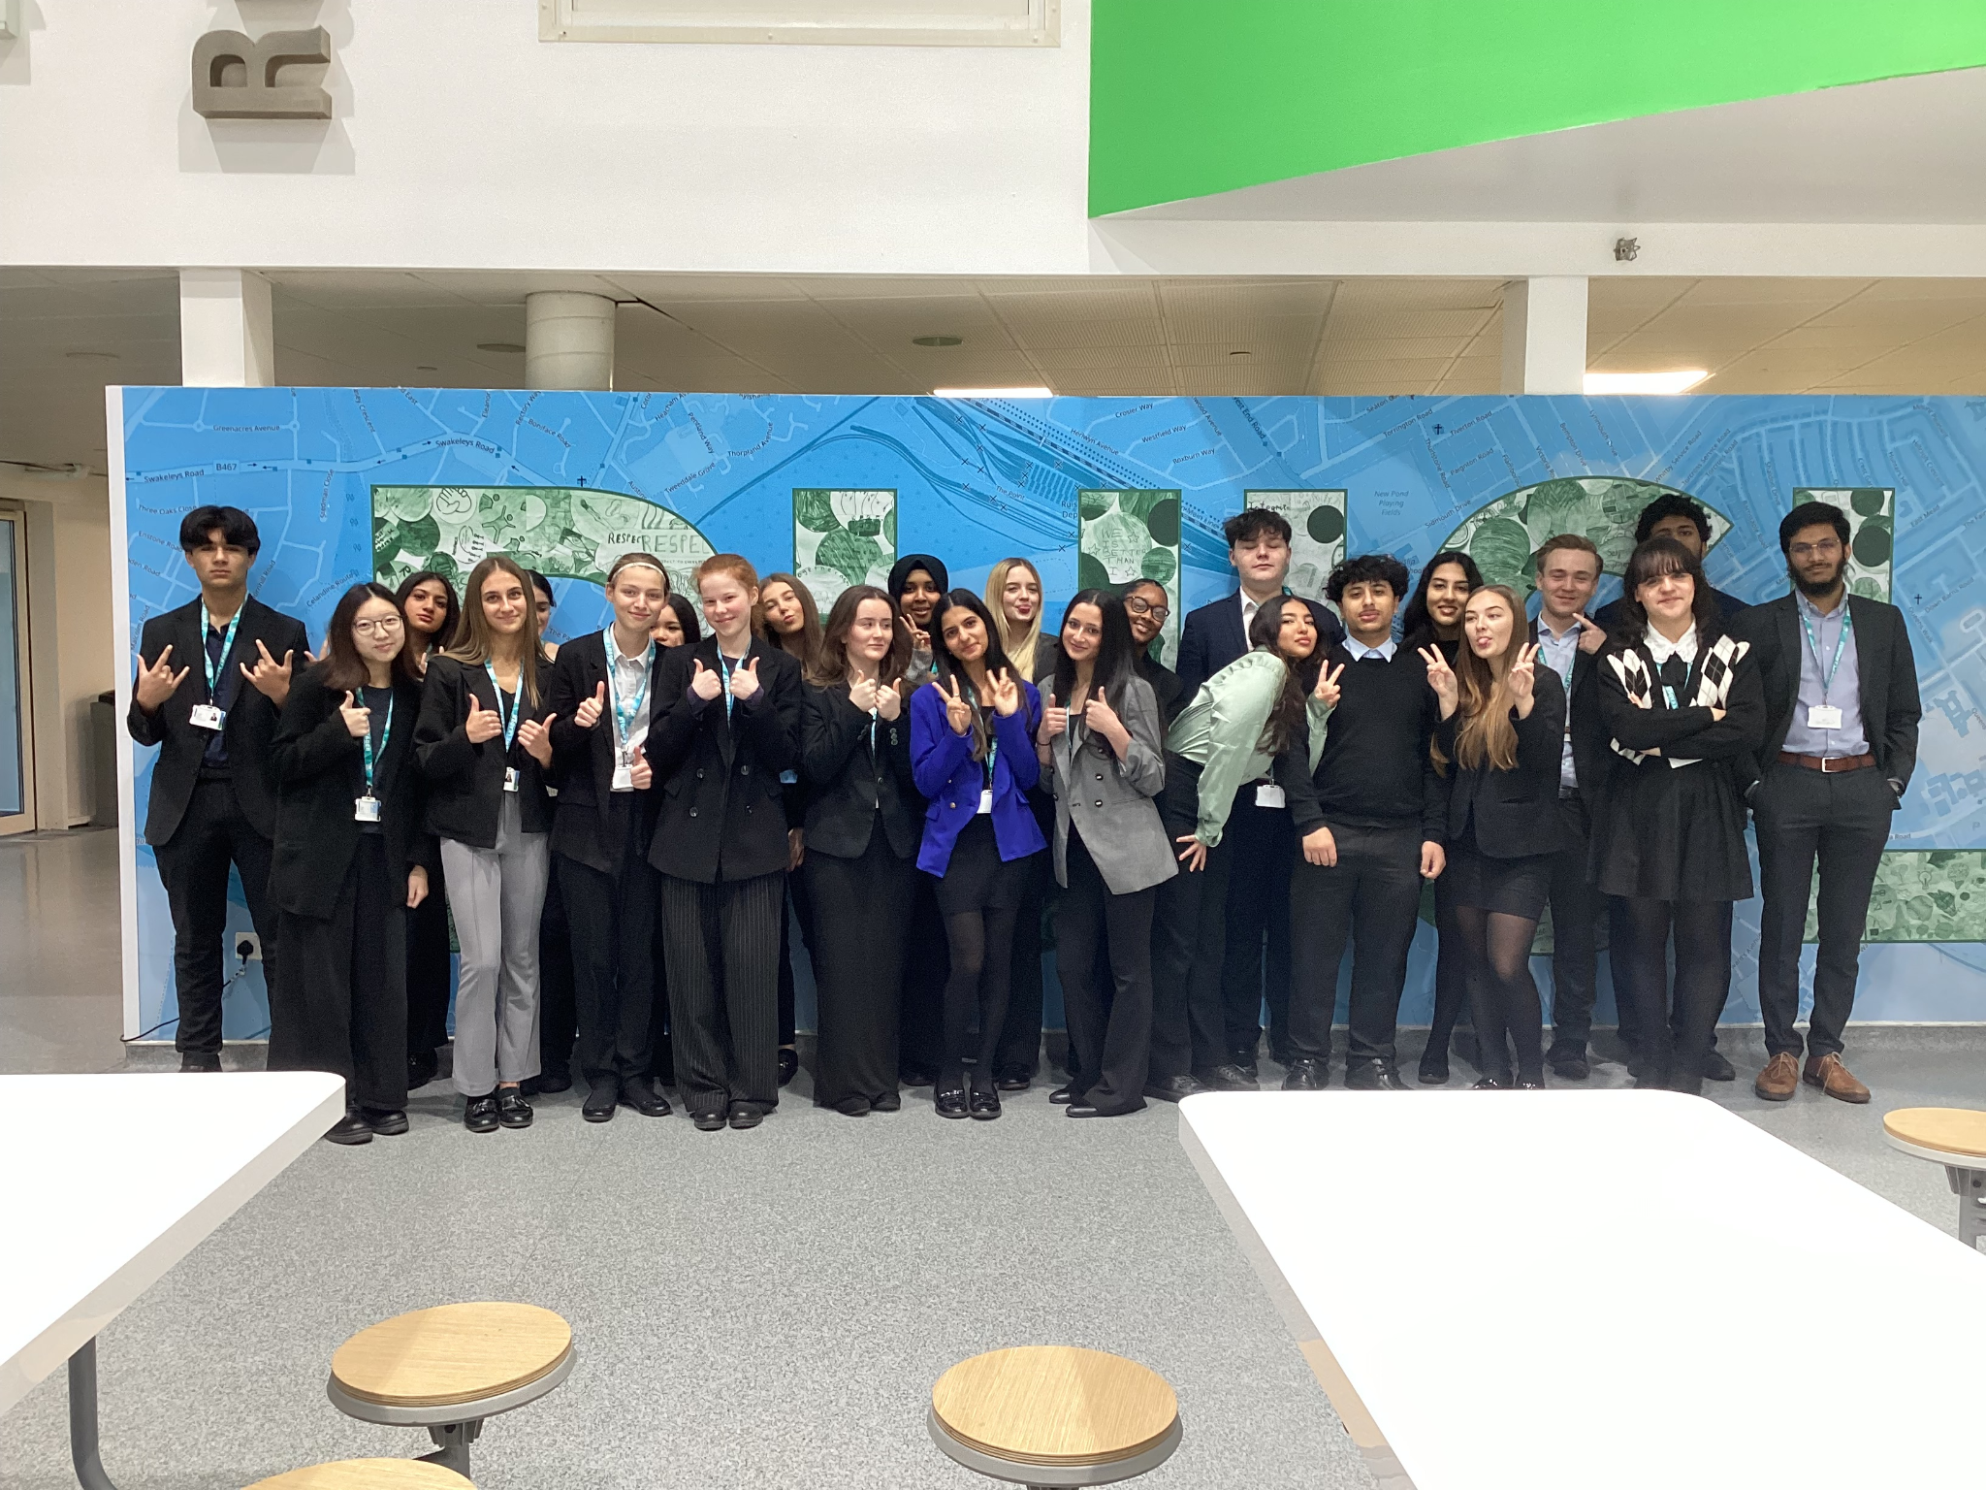
Student Leadership Team Applications 2024-2025
Why apply?
What responsibilities are involved?
What positions are available?
How do I apply?

Slide 3
Why apply to be a student leader?
You develop leadership, confidence and interpersonal skills through mentoring, assemblies, duties and public speaking opportunities.
It is your chance to “give something back” to the school.
Most student leaders describe it as fulfilling - you make a genuine difference to the school lives of younger students and the school community as a whole.
It looks great on post-18 application forms.

Slide 4
Why apply to be a student leader?
“What I have enjoyed most about being part of the student leadership team is working with senior members of staff to implement the changes the student body want to see- being a voice for the school community” (Tia Parmar 2023-2024 Head Student)
“Being part of the student leadership team gives something back to the school and develops you as a person hugely. It also looks great on post-18 applications!” (Mr Elsby)
“As student leaders you are in the privileged position to be able to support younger students in ways they will never forget” - (Miss Kingscott)
“By being a part of the student leadership team, I help create an environment in which all students can feel comfortable, safe and accepted”
(Amina Cherif 2023-2024 Head of Equalities and Diversity)

Slide 5
What general responsibilities are involved?
You have the opportunity to shape your position with your own initiatives, so you have a certain amount of autonomy over this.
Main responsibilities for all positions involve:
Mentoring younger students/advocates for the mental health of young people
Helping at evening events such as Sixth Form Open Evening, Presentation Evening, the Christmas Community Event and Parents Evening.
Once per week duties to increase your presence around the school with younger year groups.
Helping to run an Above and Beyond club of your choice.
Running charity events throughout the year (bake sales etc)
Attending fortnightly meetings during enrichment time.

Slide 6
What positions are available to apply for?
Head Student
Deputy Head Student (x2)
Head of Year 7
Head of Year 8
Head of Year 9
Head of Year 10
Head of Year 11
These major roles involve speaking at events such as Presentation Evening and Sixth Form Open Evening, as well as maintaining a high profile around the school and leading occasional assemblies for younger year groups.
In these roles you would liaise closely with the staff Head of Year for that year group to help mentor and support students who are struggling with school. This gives you an excellent chance to inspire them and make a genuine difference to their lives.
You will also deliver an assembly to that year group to inspire them, and will occasionally visit tutor time.

Slide 7
What positions are available to apply for?
Head of Student Wellbeing x 4
Head of Mentoring x2
Head of Fundraising x2
Head of Events x3
Head of Equalities and Diversity x2
Head of Above and Beyond Clubs x2
These slightly smaller, but still very important, roles help look after specific areas of Sixth Form life, such as:
Helping new students acclimatise to life at RHS.
Helping to organise events such as Prom.
Helping to gather volunteers for key events.
Supporting the wellbeing of students and raising awareness of mental health
Helping to run charity events for themed weeks throughout the year
Supporting year group assemblies

Slide 8
Events we have run this academic year………
Christmas Community Event
Easter Egg hunt
Rag Week (sponge the teacher, Splash Dash, penalty shoot out etc)
Mentoring of younger year students

Slide 9
The Guest Speaker Programme
What is the guest speaker programme?
Since 2016 the Sixth Form has organised a guest speaker programme every fortnight as part of the Year 12 timetable. This runs along the theme of the "3Cs", with each visitor speaking about careers, culture or current affairs. Our guests talk for about 20-25 minutes, followed by about 5 minutes of Q&A. Some speakers visit in person whereas others join us live on Zoom.
Examples of guest speakers:
Stephen Hart from Positive Voices (Terrence Higgins Trust HIV and sexual health charity)
Shaan Knan from GIRES (Gender Identity Research and Education Society).
Archita Patel from Conscious Planet.
Sue Alexander from WaterAid.
Stephen Welton, CEO of Business Growth Fund (BGF).
Daya Mangat, Kooth mental health website.
Eric Salama, Chair of Comic Relief.
Nick Ross, former Crimewatch presenter.
Any suggestions?

Slide 10
Success at RHS Sixth Form
What do you think makes a successful student at sixth form?
Pair- share

Slide 11
Success at RHS Sixth Form
Respect
Unity
Integrity
Self Discipline- independent learning
Learning- new subjects, new concepts!
Inspiration
Perseverance- work-life balance

Slide 12
Success at RHS Sixth Form
Communication:
At sixth form, open conversations with your teachers, tutors and peers is essential to success. Whether those conversations be about school life or pastoral concerns, it is important students talk honestly, openly and respectfully with staff!
Google Classroom: Most of the communication you have regarding your schedule will be via google classroom- specifically your learning mentors Ms Kwan and Ms Bonny. They will inform you of opportunities, study referrals and timetable changes.

Slide 13
Remember that across all your relationships, you should always:
Speak in a polite tone
Say ‘good morning’ or ‘good afternoon’ when you pass people in the corridor
Always say please and thank you!
But also remember that staff members are not…

Slide 14
You have been given a study referral that you are certain was a mistake. What do you do?
Your manager at work tells you that you are constantly late when you have been arriving on time. What do you do?
Even if you disagree with something: remain calm and polite
Ask for help from the Sixth Form Team (Tutors, Learning Mentors, Mr Elsby, Mr Peacock, Ms Horton)
Do not argue back, this will always result in higher level sanctions

Slide 15
Success at RHS Sixth Form
At sixth form, you will have lots of things you may need to juggle at one time, hence the skill of organisation is key.
Google classroom will always inform you of upcoming work assignments and their due date. It is vital you check google classroom every day so to avoid missing any notification.
Subject organisation:
Ask your subject teacher what they expect from you. Do they want you to have a folder with topic dividers? Do they want you to have a designated book that you make the notes in? You teacher will always be there to help you to get organised.
The earlier you get organised in sixth form, the easier it will be to juggle your tasks and avoid things like study referrals for missed work etc.

Slide 16
Success at RHS Sixth Form
Resilience
Passionate
Open-minded
Personal Qualities
Kindness
Studious
Hard-working
Tolerant
Understanding

Slide 17
Any questions?

