Slide 1
Positive Wellbeing & Behaviour Habits
Sixth Form Induction Day

Slide 2
The Daily 5 Choices
Stress Breaks (regular)
Sweat for 15 minutes (aerobic exercise)
Sleep (8+ hours)
Sunlight (have your room in darkness 30 minutes before bed & 30 mins after waking)- Go outside!
Socialise (prioritise people)

Slide 3
Sleep
“Chronic sleep loss and associated sleepiness and daytime impairments in adolescence are a serious threat to the academic success, health, and safety of our nation’s youth and an important public health issue.” (Owens, 2014)
Adolescents need approximately 9 hours of sleep a night. (Blakemore, 2018)
The main factors contributing to chronic sleep loss in adolescents are electronic media use (blue light suppresses release of melatonin) and caffeine consumption (caffeine has a half-life of 5 hours).
The main health-related consequences of sleep deprivation are depression, increased obesity risk and lower academic achievement.

Slide 4
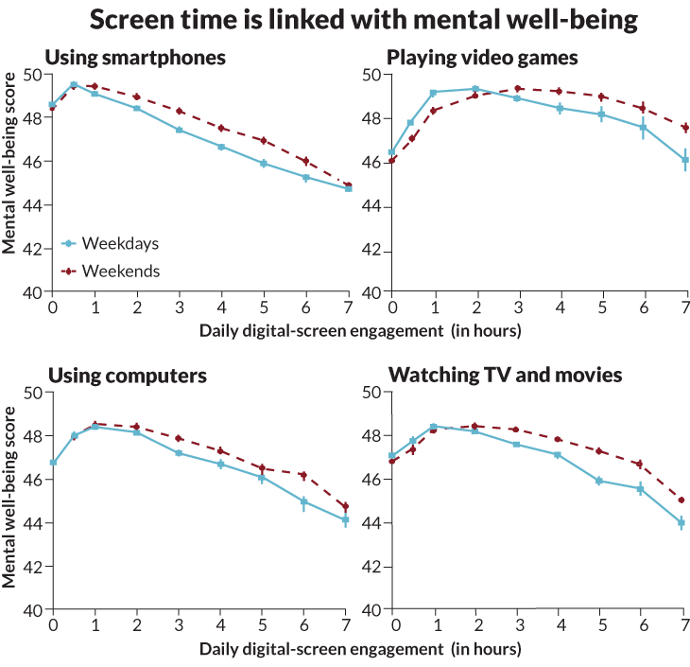
Screen time and mental wellbeing

Slide 5
Why Exercise Helps High School Students Learn Better
Boosts Brain Power – Improves memory, focus, and learning by increasing blood flow and brain chemicals.
Improves Focus – Just 20–30 minutes of exercise can sharpen attention for hours.
Reduces Stress – Lowers anxiety and helps manage school-related pressure
Consistency is Key – Moderate daily movement is more helpful than intense workouts once in a while.
Balance Matters – A mix of cardio, strength, and stretching keeps the body and brain at their best.

Slide 6
Top Nutrition Tips for School Success
Eat Breakfast – Helps you focus and learn better. Start your day right!
Drink Water – Staying hydrated boosts energy and memory.
Avoid Too Much Sugar – It can make you crash and lose focus.
Fuel Your Brain with Nutrient-Rich Food – Foods rich in Omega-3s, Iron, and Complex carbs with help maintain long lasting energy, focus, and memory
Cut Back on Energy Drinks – They mess with sleep and focus.

Slide 7
Behaviour: Acting Like A Sixth Form Student

Slide 8


Why is good communication important?
Maintain positive relationships with those around you
Teachers, friends, parents, coworkers, employers, hospitality/ service workers
Preparation for the future - university and the workplace

Slide 9



Remember that across all your relationships, you should always:
Speak in a polite tone
Say ‘good morning’ or ‘good afternoon’ when you pass people in the corridor
Always say please and thank you!
But also remember that staff members are not…

Slide 10
Positive Habits Task
Now I want you to write down your top 3 positive habits and explain why they are beneficial to you.
I will select a few of you to discuss your answers.

