Slide 1
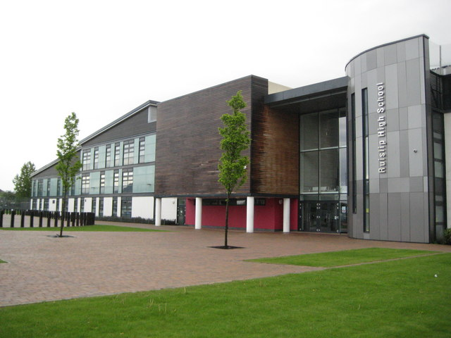
Dear future Year 7 student,
Hello! My name is Ms Loizou and I will be your Head of Year when you join us in September.
I am looking forward to coming to meet lots of you at your primary schools over the course of this year.
I thought I would send you this note to introduce myself and tell you a little bit about your new school.
I am so excited to meet you all face to face as you start the next big journey… High School! As your Head of Year I am one of the people that you can come and speak to if you have any concerns (as well as your teachers, form tutor and the pastoral team). I will be here for you and help you as you get used to this transition from Year 6 into Year 7.
When you join us it will be natural to feel nervous. Some of you are coming from schools with lots of friends and some of you are the only person coming from your primary school. I can guarantee that despite being nervous you will soon settle in and would have made some new friends in your tutor groups. It also won’t take you long to get to know the building. It usually takes about three days to work out your way around and older students and staff will always be happy to help you. These are usually the things that students are most nervous about so I hope I have made you feel a bit more confident about joining us!
I will be sending you more messages. In the meantime, keep working hard and enjoy the summer!
All the best,
Ms Loizou
Head of Year 7

