Slide 1
Sixth Form Induction Day 2025
Post-18 Support

Slide 2
The aims of this session…
To introduce you to different post-18 routes.
To give you an idea of the post-18 process in the Sixth Form.
To start planning your post-18 evidence building.

Slide 3
What are the post-18 routes that are available to you?
University degree
Apprenticeship
Degree apprenticeship
Job

Slide 4
University Degree
If you would like to go to university to study a chosen course in a subject you are interested in, then you will need to go through the following process:
What is the process you go through when applying for university?
Research courses and institutions in the field you are interested in.
Check entry requirements to ensure they are achievable in relation to your progress in your subjects (you will have a better idea of this towards the end of Year 12).
Build evidence for your application (more on this later!).
Write your personal statement.
Complete your UCAS application, selecting up to 5 university choices.
Send off your application!

Slide 5
What subject should I study at university?
It’s important you choose a subject you enjoy and will help you reach your goals. Here are some things to help you choose the right subject for you:
Think about what you enjoy day-to-day – maybe this could be part of a future job role?
Explore different job sites and graduate career options to look for ideas on what you’d like to do once you've finished your studies.
Think about your career goals and the qualifications required.
Take a look at the UCAS subject guides (https://www.ucas.com/explore/subjects) to get an idea of the types of subjects you could study, and the industries graduates go on to work in.
Search for courses by subject to see what's available (you will do this later!).

Slide 6
Apprenticeship
Apprenticeships combine practical training in a job with study. There are many apprenticeship vacancy search engines out there but the main one is here: https://www.gov.uk/apply-apprenticeship. You will need to write a cover letter to apply and would also have an interview.
As an apprentice you’ll:
be an employee earning a wage and getting holiday pay
work alongside experienced staff
gain job-specific skills
get time for training and study related to your role (at least 20% of your normal working hours)

Slide 7
Degree Apprenticeship
A degree apprenticeship enables you to gain a full undergraduate degree while you work. Degree apprenticeships take three to six years to complete, depending on the course level.
You’ll spend most of your time working and you’ll also study part-time at university. For example, you might go to university one or two days per week, or in short blocks, such as a week at a time. Overall, you spend about 20% of your time studying vs. 80% of your time working.

Slide 8
Employment
You will need to research different areas of employment that interest you.
You will also need to research the progression routes in different careers you find interesting. Think about your goals in terms of progress and where you would like to be in that career 5 or 10 years into the career.
You will need a CV and cover letter.
You will then have an interview if the employers are impressed by your CV and cover letter.

Slide 9
How does the post-18 process work in the Sixth Form?
From the start of Year 12, you should begin building evidence to demonstrate why you are the best candidate for your chosen post-18 course (more on this later!).
Throughout Year 12, you should explore the different post-18 routes that interest you and find specific institutions/courses that you would like to apply for.
You will then have opportunities throughout the year to discuss these options with your tutors in 1:1 meetings and can also speak to our sixth form learning mentors for advice and support.
At the end of Year 12, you will have a post-18 day where you will receive support to start writing your personal statements and/or cover letters.
At the start of Year 13, you will finish your personal statements with the support of the sixth form team.
By the autumn half term of Year 13, you should have sent off your UCAS application (if applying to university). Students applying for apprenticeships will continue looking for vacancies throughout the year and should apply by March of Year 13.

Slide 10
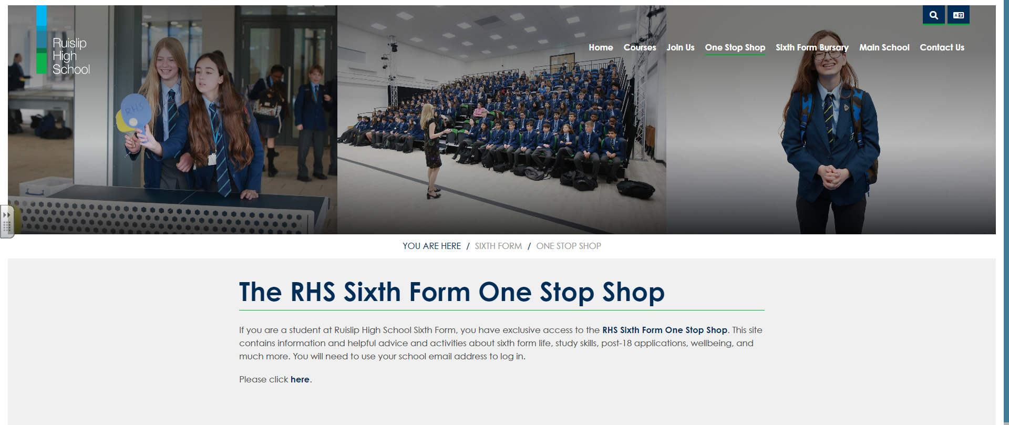
Search ‘Ruislip High School One Stop Shop’

Slide 11
On the Sixth Form One Stop Shop, there is lots of guidance on what to do when you leave RHS

Slide 13
RHS SIXTH FORM POST-18 SUCCESS STORIES

Slide 14
Post-18 Success Stories from 2024 Leavers
Ruislip High School saw the most progress in our students than any other school in the borough of Hillingdon
Seven students secured interviews with Oxford or Cambridge Universities
Parham Golbaz Shomaly went on to do a apprenticeship with a top financial firm and is loving his work.
Every student who applied for university was offered at least one place (many were offered all five!)

Slide 15
EXTENSION TASK
BUILDING EVIDENCE

Slide 16
Chromebook Research: Apprenticeships
If you are interested in applying for an apprenticeship after you leave RHS Sixth Form, then you should work through Section A of this booklet which will provide you with everything you need to know about apprenticeships.
Type the following into Google and click on the first link:
‘apprenticeship pack 16-19’

Slide 17
Why is it important to build evidence for your post-18 application?
Universities or apprenticeship providers don’t just want to hear that you are interested in their institution/courses - they want to see proof:
Proof that you have genuine interest in a subject/course/apprenticeship area.
Proof that you have acted on that interest.

Slide 18
Where to get evidence from
Wider Reading
Open Days
Website research
TV/radio programmes
Ted Talks
Newspaper articles and editorials
Work experience (online or in person)
Work shadowing
MOOCs (open online courses) - https://www.futurelearn.com/
EPQ
Lectures (online or in person)

Slide 19
Your Task
Wider Reading
Open Days
Website research
TV/radio programmes
Ted Talks
Newspaper articles and editorials
Work experience (online or in person)
Work shadowing
MOOCs (open online courses) - https://www.futurelearn.com/
EPQ
Lectures (online or in person)
Do research to find post-18 evidence linked to the post-18 courses/subjects you found earlier.
You can then start to work on building this evidence in the summer and throughout Year 12.
Click on a subject under ‘Degree Subjects’
Scroll down to find ‘What can I do to make my … competitive’

Slide 20
RESEARCH TASKS

Slide 21
Research: University Degrees
If you are interested in applying to university after you leave RHS Sixth Form, then you should use the UCAS website to search through courses in subject areas that interest you.
Use the UCAS search tool here:
https://digital.ucas.com/search
Your Task: On a Google Doc, record all of your research on the different courses and institutions you find.
Things to think about including:
Course title and code
Institution name
Modules that interest you
Modules that you are not too sure about and need to do further research on
Entry requirements
Career options after completing this degree
Take a look at the UCAS subject guides here to help you with this task: https://www.ucas.com/explore/subjects
You can also use the One Stop Shop

Slide 22
Login details for external students
Username: guest@ruisliphigh.org.uk
Password: password
guest01@ruisliphigh
up to
guest07@ruisliphigh

