Slide 1
The RHS Post-16 Bursary

Slide 2
The RHS Post-16 Bursary
2025-26

Slide 3
What is the RHS Post-16 Bursary?
The RHS Post-16 Bursary is a fund used by the school to support student with the costs of school-related items.
The awarding of funds from the bursary is contingent on household income and strong attendance.

Slide 4
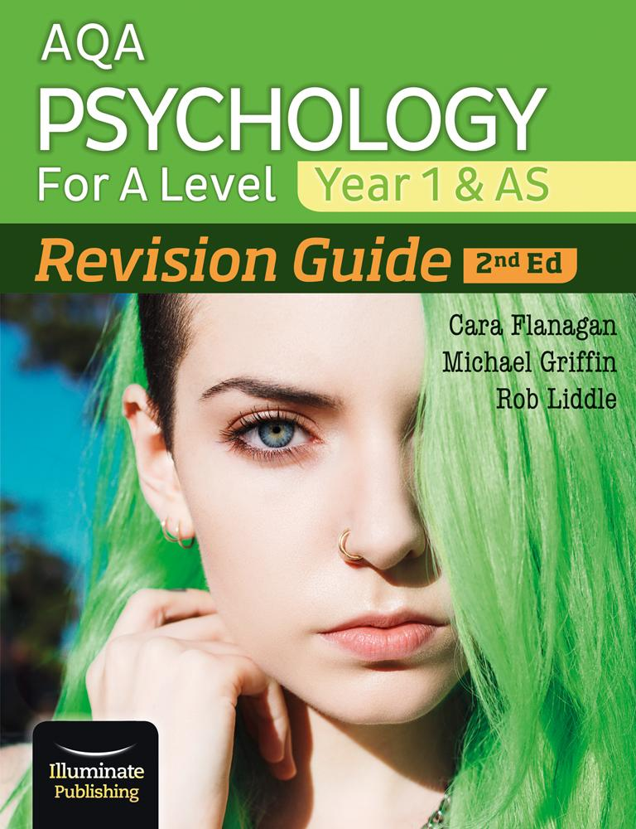
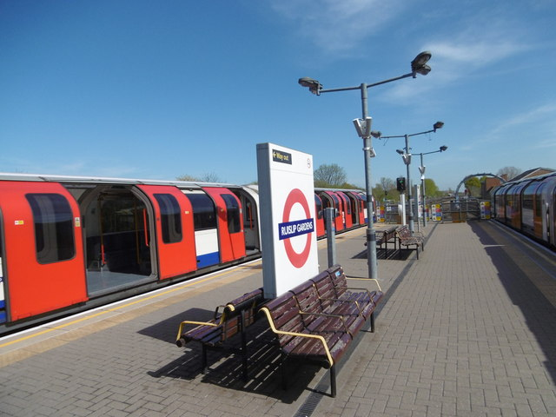
How can it help me?
The RHS Post-16 Bursary can only be used to meet costs directly associated with your studies in the sixth form.
So for example, we can help pay for revision guides, travel to and from school, and any item of clothing that fits the dress code.
We cannot pay for anything that doesn’t directly link to your studies, such as your university application, clothing that does not fit the dress code, extracurricular school trips, and tuition outside of school.

Slide 5
Who is eligible?
Vulnerable Groups - Automatically eligible for up to £150
● Young people who are currently in care, or who are care leavers
● Young people who are unaccompanied asylum seekers and students in Local Authority provided foster care)
● Young people who claiming Income Support/Universal Credit in their own name
● Young people who are 16-19 and in receipt of both Employment and Support Allowance/Universal Credit and Disability Living Allowance/Personal Independence Payment

Slide 6
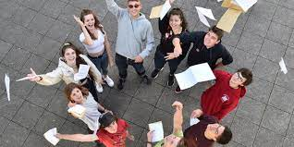
How do I apply?

Slide 7
Bursary guide - August 2025
If your household’s total annual income is below £31,500 per year, you may be eligible for the Sixth Form bursary. Please click here to make an account and apply (applications are open from 22nd August 2025 onwards).
Here is a selection of stores you can purchase from and some ideas of clothing you will be able to purchase up to a total value of £150.
Stores: H&M, Marks & Spencer, Next, New Look, Zara
Your textbook deposit and UCAS fee will be paid for you separately to this.
Please have a look at the examples of how students can spend their allowance here.
Pieces of clothing will only be ordered if they comply with the Sixth Form dress code.
All items will be ordered for you so sizes MUST be clearly shown on the form.

Slide 8
Above & Beyond Clubs
Why apply?
What responsibilities are involved?
What positions are available?
How do I apply?

Slide 9
Above & Beyond
Joining an Above & Beyond activity is not only fun, it will build your character, enable you to meet new people with similar interests, develop your skills, make you more employable, enhance your college course and academic studies and generally help you to become a more well-rounded young person.

Slide 10
Clubs running
Sixth Form Focus - articles
The 'Sixth Form Focus' is a termly newsletter that is produced and written by and for Sixth Form Students. It has been a longstanding tradition that I would like to reinstate! It's a great way for you to share your views and get the chance to have your written work published, no matter what you are interested in. Students have previously written articles on everything from politics to film reviews to skin care recommendations.
Advanced Science Club - Mr Collins
The intention of the Advanced Science Club is to give students the opportunity to research and discuss recent developments within the world of science. Students will be provided with a chromebook and invited to independently research current events within science. For example in today's news is the return to Earth of a probe which has sampled rock from an orbiting asteroid, this is the first time this has been achieved and scientists believe these rock samples may hold important information on the birth of our solar system and even the beginnings of life on our planet.
Students will be encouraged to share and discuss the results of their research.

Slide 11
TED Talks Club - Ms Carley
TED Talks showcase the ideas and arguments of some of the worlds leading thinkers and doers on topics ranging from science and technology to the arts and social issues. In this club we will watch and discuss a selected TED talk each week. Suggestions of TED talk videos and topics will be welcome. At the end of each term any interested students in the club will have the opportunity to give a 3 - 5 minute TED talk of their own.
Fantasy Football Club - Mr Reynolds
Have you ever played fantasy football? Do you want to start? Do you want to understand how to be successful at a game that can even make watching Burnley v Crystal Palace exciting? Then Fantasy football club is the one for you.
Make no mistake it will not (just) be a fortnightly conversation about football. You will gain a better understanding of investment, statistical analysis and strategic planning. You will also be expected to do research and extra reading. Club members will present to a supportively critical audience regularly too.

Slide 12
Games Club-Ms Vaghela
Playing board games enhances creativity and self-confidence. It is a great way to stimulate the brain and improve the following cognitive skills; decision making, higher level strategic thinking, and problem solving. In this club you will partake in speed chess, cards, scrabble, backgammon or checkers. Could you be our term champion? Whether you love board games or think you hate them, this club could be for you! Come along and give it a go!
STEM Club - Mrs Poddar
Are you interested in the newest developments in technology? Do you want to know how AI and Machine Learning works? Develop problem solving skills and be prepared for the future. Meet inspiring professionals who will talk to you about future careers and much more.

Slide 13
UKMT Maths Club - Ms Jani
Promoting a love of problem solving
The Senior Mathematical Challenge is a 90-minute, multiple-choice Challenge.
It encourages mathematical reasoning, precision of thought, and fluency in using basic mathematical techniques to solve interesting problems.
The problems on the Senior Mathematical Challenge are designed to make students think. Most are accessible, yet still challenge those with more experience.
A great thing to put on your personal statement if you are considering a maths or science related subject at university.

Slide 14
Ideas
Duke of Edinburgh (which stage)
Music/Dance grades
Formal sports clubs (not just playing football in the park)
Your work experience placement (what did you do?)
Essay competitions
Brilliant Club
EPQ - include your title
In-person lectures
University taster days (open days do not count)
Sutton Trust
K+
Winning awards in school for subjects or the Headteachers award

